Slide 1


Data Preprocessing

Slide 2
What is data preprocessing?
An important step in the data analysis process
The process of cleaning, transforming, and organizing raw data before it can be used for analysis.
Ensures that the data is accurate, complete, and in a format that is suitable for analysis.

Slide 3
Why data preprocessing is important?
Improves Data Quality: Data cleaning and transformation ensure that the data is accurate, complete, and consistent. This improves the overall quality of the data and helps to ensure that the analysis is accurate and reliable.
Increases Analysis Accuracy: Data preprocessing techniques such as normalization and feature selection can help to improve the accuracy of the analysis by reducing noise and improving the relevance of the data.
Enhances Efficiency: Preprocessing can also help to improve the efficiency of the analysis by reducing the amount of time and resources required for data cleaning and transformation.

Slide 4
Why data preprocessing is important?
Enables Better Decision Making: By providing clean and reliable data, preprocessing enables organizations to make better and more informed decisions based on the analysis of the data.
Supports Machine Learning: Machine learning algorithms often require clean and preprocessed data to be effective. Data preprocessing ensures that the data is in a format that can be used by these algorithms, allowing for more accurate and effective predictions.

Slide 5
Main Steps of Data Preprocessing
Data Cleaning: This involves removing or correcting any errors or inconsistencies in the data, such as missing values, incorrect values, or duplicates.
Data Transformation: This involves converting the data into a format that is more suitable for analysis, such as scaling, normalization, or converting categorical data into numerical data.
Data Integration: This involves combining data from multiple sources to create a unified dataset.
Data Reduction: This involves reducing the size of the dataset while maintaining its integrity, such as by using sampling or feature selection.
Data Discretization: This involves converting continuous data into discrete values, such as by grouping data into intervals or categories.

Slide 6
Data Cleaning
Removing Duplicate Records: Duplicate records can occur when the same data is entered multiple times, and they can skew analysis results. Removing duplicate records helps to ensure that the data is accurate and unbiased.
Handling Missing Data: Missing data can occur when there are data entry errors, data is not collected, or data is intentionally withheld. Handling missing data involves identifying missing values and choosing an appropriate method to deal with them, such as imputation or removal.
Correcting Inconsistent Data: Inconsistent data occurs when data values are inconsistent with other data in the same dataset. For example, if a dataset contains age data for individuals, an inconsistent data value might be a negative age or an age greater than 100. Correcting inconsistent data involves identifying and correcting these errors.

Slide 7
Data Cleaning
Standardizing Data: Standardizing data involves converting data values into a common format, such as converting dates to a consistent format or converting data values to a consistent unit of measurement.
Removing Outliers: Outliers are extreme values in the dataset that can skew analysis results. Removing outliers involves identifying these extreme values and deciding whether to remove them from the dataset or transform them to more reasonable values.

Slide 8
Data Transformation
Normalization: Normalization is the process of scaling numeric data to a common range, such as between 0 and 1 or -1 and 1. Normalization can help to ensure that all variables are on the same scale and can be compared accurately.
Encoding: Encoding is the process of converting categorical data into a numerical format that can be used in analysis. There are several encoding methods, including one-hot encoding, label encoding, and binary encoding.
Aggregation: Aggregation involves summarizing data into a more compact format. For example, data can be aggregated by taking the mean, median, or sum of a set of values.

Slide 9
Data Transformation
Feature Extraction: Feature extraction involves identifying relevant features or variables in a dataset and transforming them into a more useful or compact format. For example, text data can be transformed into a bag-of-words representation, where each document is represented as a set of words and their frequencies.
Dimensionality Reduction: Dimensionality reduction involves reducing the number of features in a dataset while retaining the most important information. This can help to reduce the size of the dataset and improve the efficiency and accuracy of analysis.

Slide 10
Data Integration
ETL (Extract, Transform, Load): ETL is a data integration process that involves extracting data from multiple sources, transforming it into a common format, and loading it into a destination system. ETL typically involves using specialized tools and software to automate the process.
Data Virtualization: Data virtualization is a technique that allows data to be accessed and used as if it were in a single database, even though it may be stored in multiple sources. This approach can help to reduce the complexity and cost of data integration.

Slide 11
Data Integration
API Integration: API integration involves using APIs (Application Programming Interfaces) to connect to and integrate data from different systems. APIs provide a standardized way for different systems to communicate with each other and exchange data.
Manual Data Integration: Manual data integration involves manually combining data from different sources, such as copying and pasting data into a spreadsheet. This approach can be time-consuming and error-prone, but it may be necessary in some situations.

Slide 12
Data Reduction
Sampling: Sampling involves selecting a subset of the data to analyze. Random sampling selects data points at random from the dataset, while stratified sampling selects data points based on a specific characteristic, such as age or income level.
Feature Selection: Feature selection involves selecting a subset of the features or variables in a dataset to analyze. This can be done by using statistical techniques to identify the most important variables, or by using domain knowledge to select variables that are most relevant to the analysis.

Slide 13
Data Reduction
Principal Component Analysis (PCA): PCA is a technique for reducing the dimensionality of a dataset by transforming the variables into a smaller set of uncorrelated variables, called principal components. This can help to reduce the size and complexity of the dataset, while retaining the most important information.
Data Cube Aggregation: Data cube aggregation involves summarizing the data along multiple dimensions, such as time, location, and product, to create a smaller, more manageable dataset. This can be useful for analyzing large datasets with many variables.

Slide 14
Data Discretization
Equal width discretization: This method divides the range of values into equal-width intervals. For example, if the range of a variable is from 0 to 100, and we want to divide it into 5 intervals, each interval would have a width of 20.
Equal frequency discretization: This method divides the data into intervals with equal number of values in each interval. For example, if we want to divide a variable into 5 intervals, each interval would contain 20% of the data.
K-means clustering: This method uses clustering techniques to group similar values into clusters, and then assigns each cluster to a category or interval.
Entropy-based discretization: This method uses information theory to measure the entropy or information content of each interval, and selects the intervals that maximize the information gain.

Slide 15
Coding Lab

Slide 16
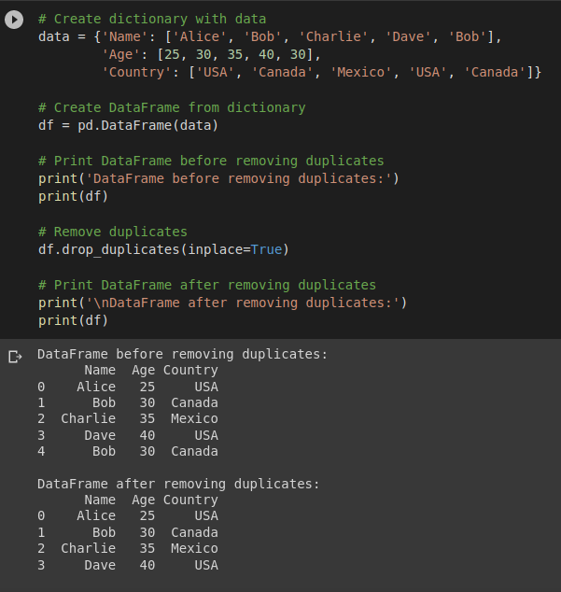
Cleaning - Removing Duplicate Records

Slide 17
Cleaning - Handling Missing Values
Ignoring the missing values:
It will degrade the performance of machine learning (ML) and deep learning (DL)models. It might also result in error for training the ML and DL models.
Deletion: deleting any row or column containing missing values
Listwise deletion: deleting all rows with missing values
Pairwise deletion: using available data for each pair of variables, even if one variable has missing data
Imputation: replacing missing values with an estimated value based on the available data
Mean imputation: replacing missing values with the mean of the available values
Median imputation: replacing missing values with the median of the available values
Mode imputation: replacing missing values with the mode of the available values
Regression imputation: using regression to estimate missing values

Slide 18
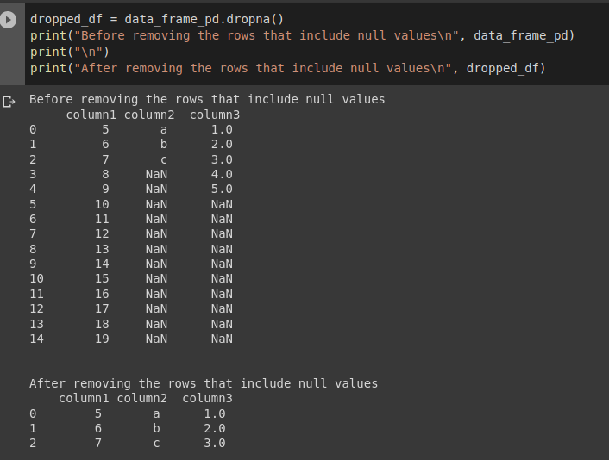
Cleaning - Handling Missing Values
Deletion

Slide 19
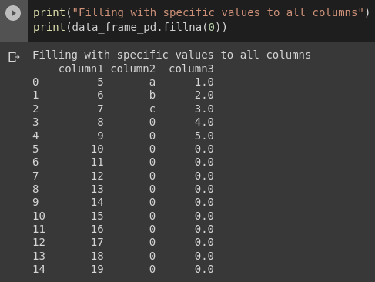
Cleaning - Handling Missing Values
Imputation
Format : dataframe[column_name].fillna(value, inplace=False)
if (inplace = True) >> it will be permanent
if just for testing >> ignore it or make it (inplace = False)
Imputation - Fill with specific value

Slide 20
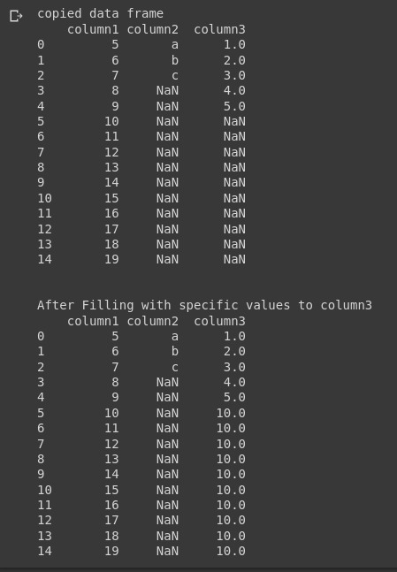
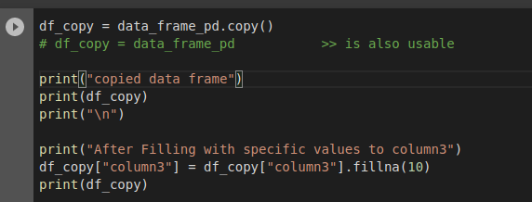
Cleaning - Handling Missing Values
Imputation - Fill with specific value

Slide 21
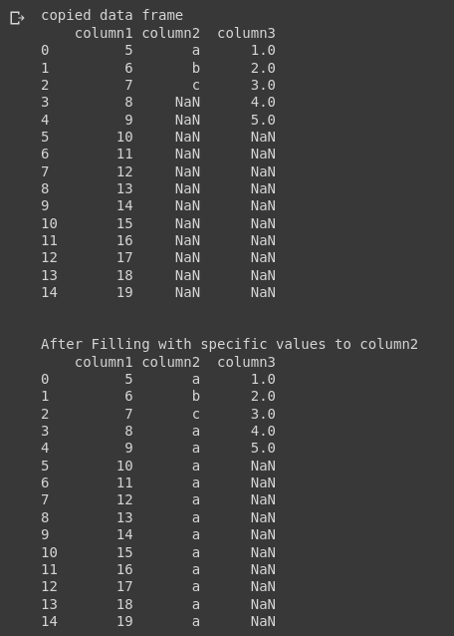
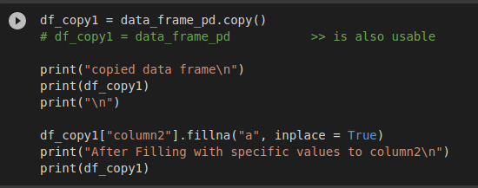
Cleaning - Handling Missing Values
Imputation - Fill with specific value

Slide 22
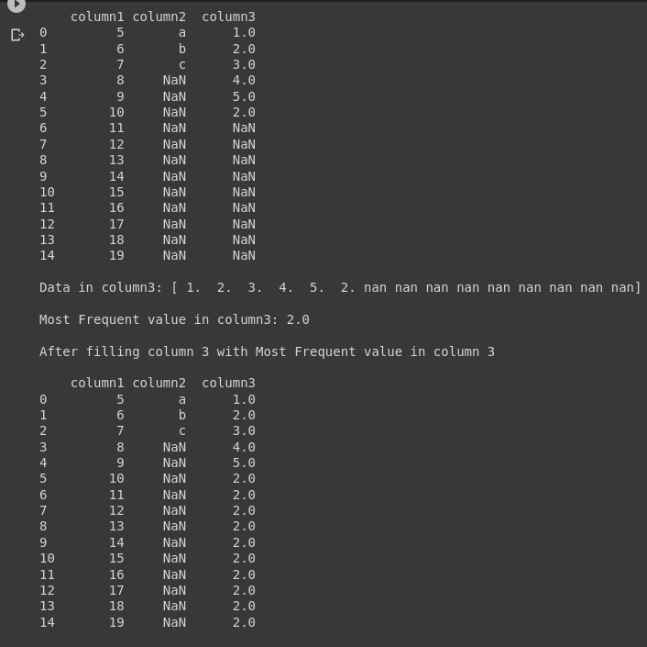
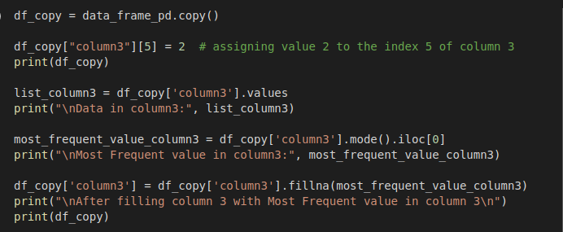
Cleaning - Handling Missing Values
Imputation - Fill with most frequent value

Slide 23
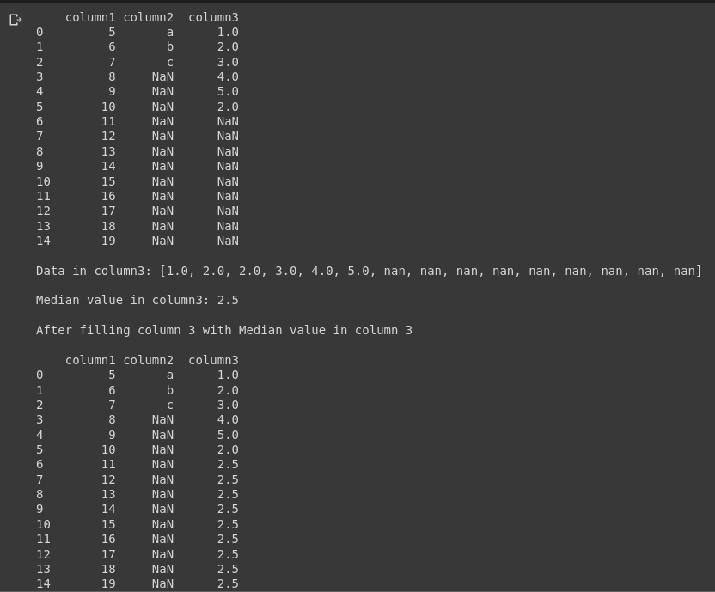
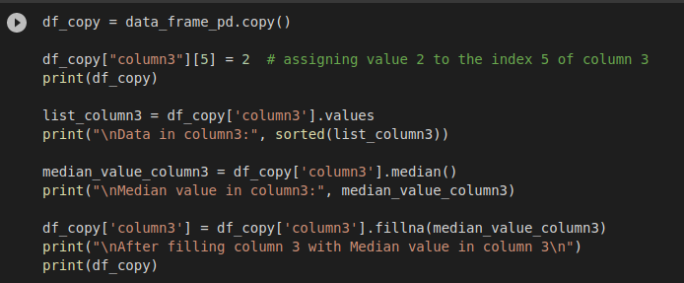
Cleaning - Handling Missing Values
Imputation - Fill with median value

Slide 24
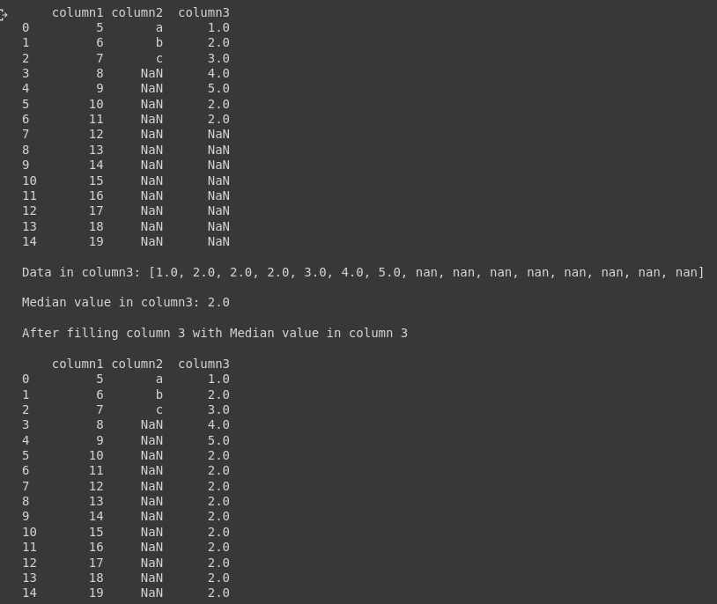
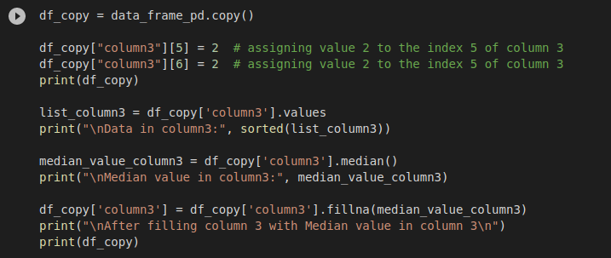
Cleaning - Handling Missing Values
Imputation - Fill with median value

Slide 25
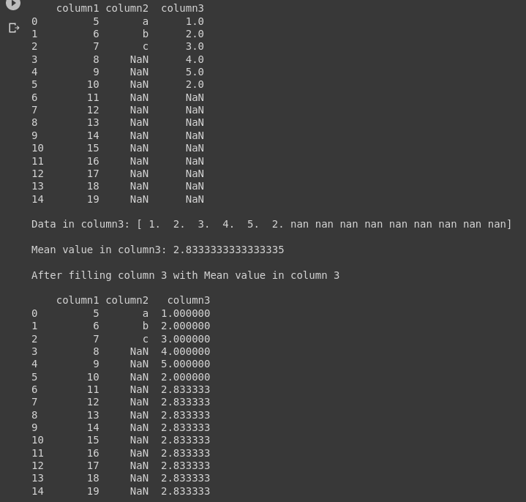
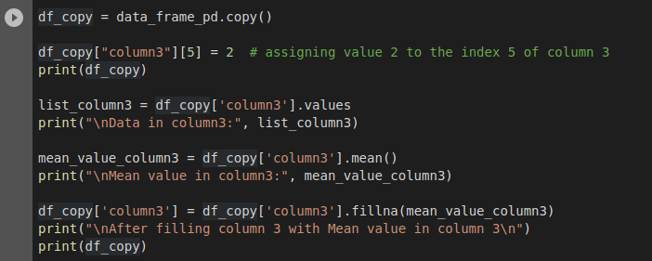
Cleaning - Handling Missing Values
Imputation - Fill with mean (average) value

Slide 26
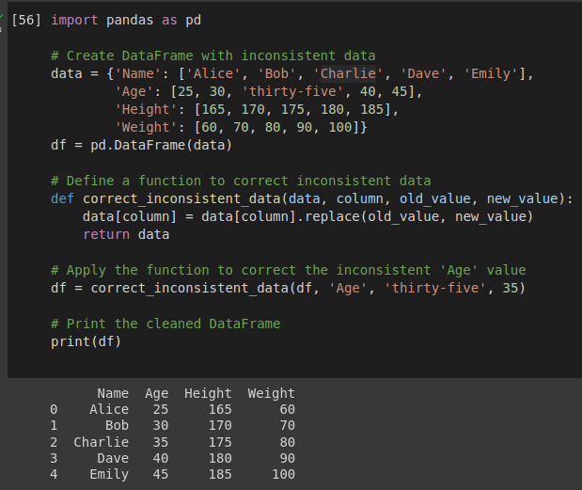
Cleaning - Correcting Inconsistent Data

Slide 27
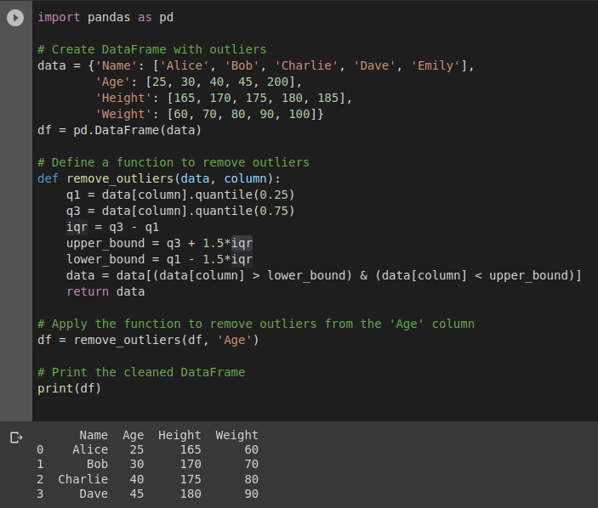
Cleaning - Outlier Removal
Interquartile range (IQR): The function computes the IQR of the column and defines upper and lower bounds as 1.5 times the IQR above and below the first and third quartiles, respectively.

Slide 28
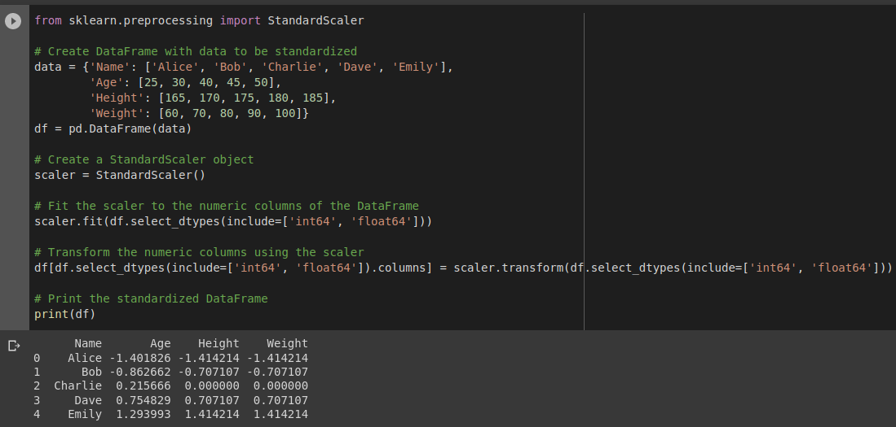
Cleaning - Standardizing Data
Data preprocessing technique that transforms the data to have a mean of zero and a standard deviation of one.
This is also known as z-score normalization. The purpose of standardization is to rescale the data so that each feature (column) has a similar range and distribution

Slide 29
Transformation
We have to follow these steps for this part.
Fill all missing value before assigning string data type to numerical data type.
Check data_types to see which columns has object data type.
Select those and see what data values are inside those columns.
Assign those string values with numerical data type (int or float).

Slide 30
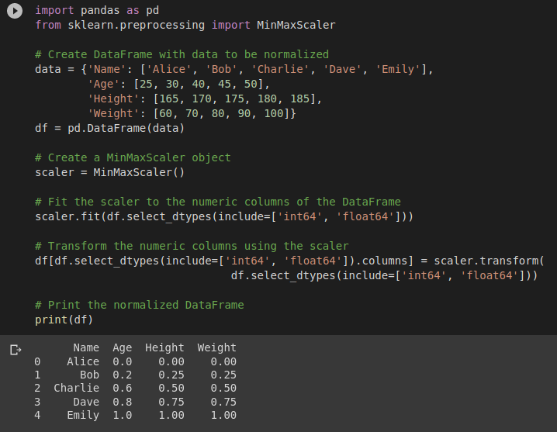
Transformation - Normalization
Data preprocessing technique that rescales the data to have values between 0 and 1, or sometimes -1 and 1.
The purpose of normalization is to bring all features of the data to the same scale, so that no one feature dominates the others.

Slide 31
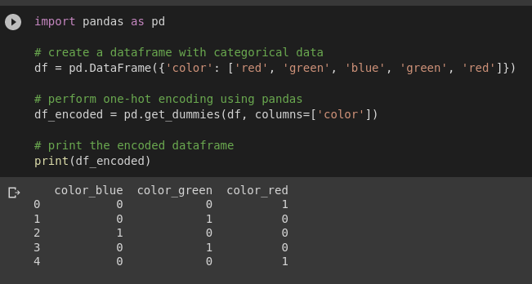
Transformation - Encoding
The process of converting categorical data into numerical format so that it can be used as input for machine learning models.
One-Hot Encoding
This technique involves creating a new binary variable for each category in a categorical variable.

Slide 32
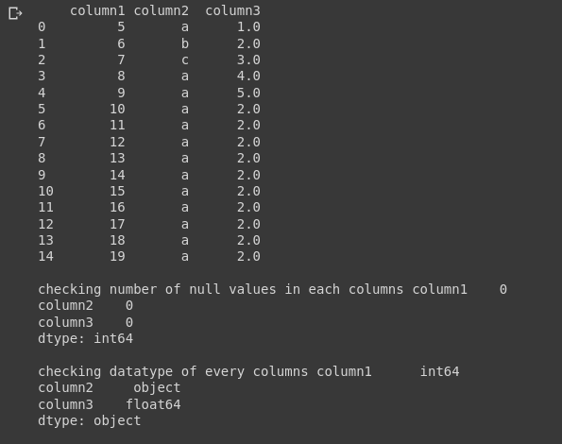
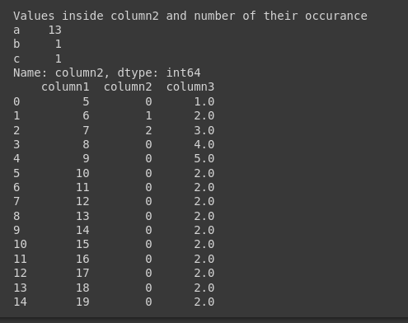
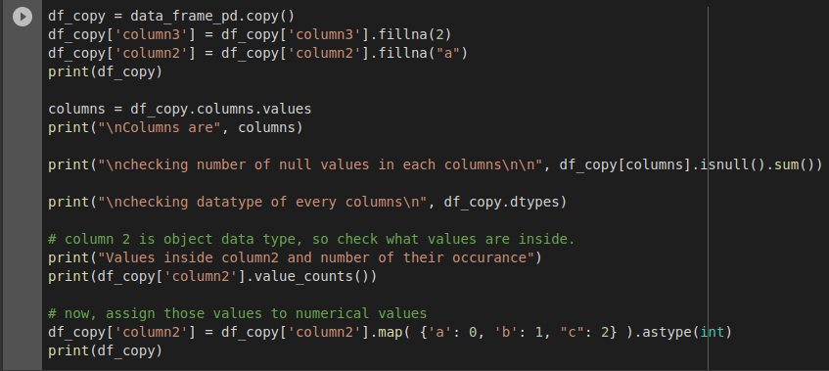
Transformation - Encoding
Label Encoding
This technique involves assigning each unique category in a categorical variable with a numerical value.

Slide 33
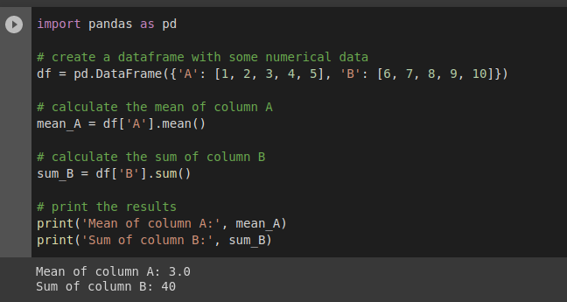
Transformation Aggregation
The process of combining multiple values into a single value by applying a mathematical function.

Slide 34
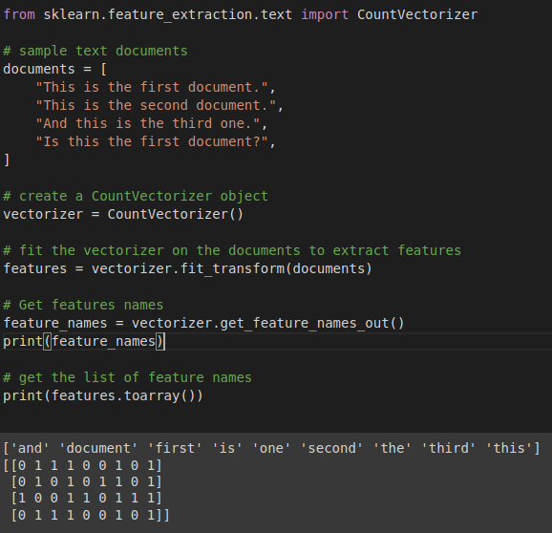
Transformation - Feature Extraction
A process of selecting and transforming relevant features from the raw data to create a set of meaningful features that can be used for machine learning.

Slide 35
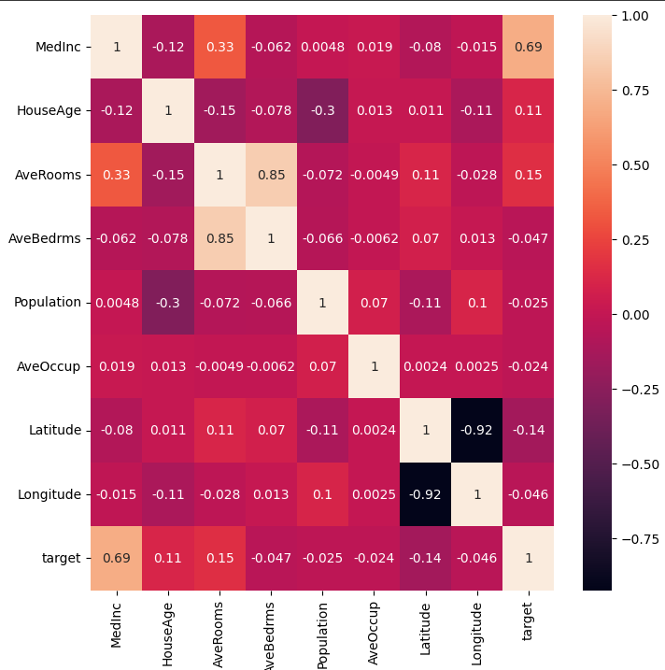
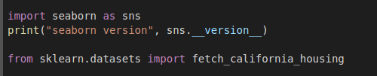
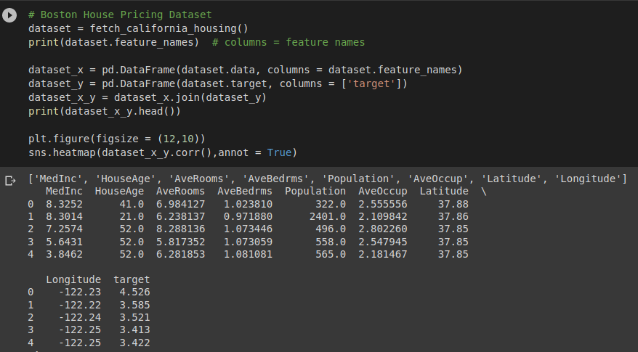
Reduction - Feature Selection
Selecting Features

Slide 36
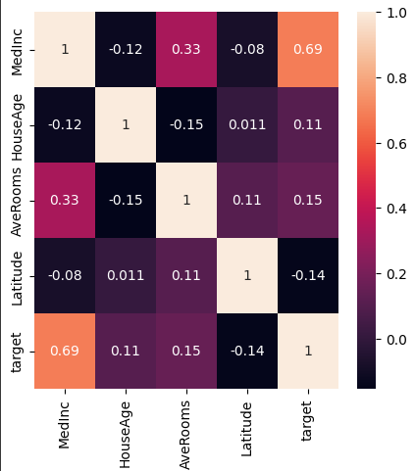
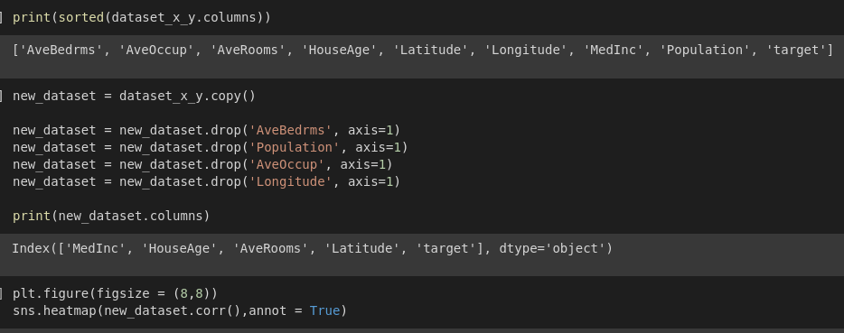
Reduction - Feature Selection
Dropping Features

Slide 37
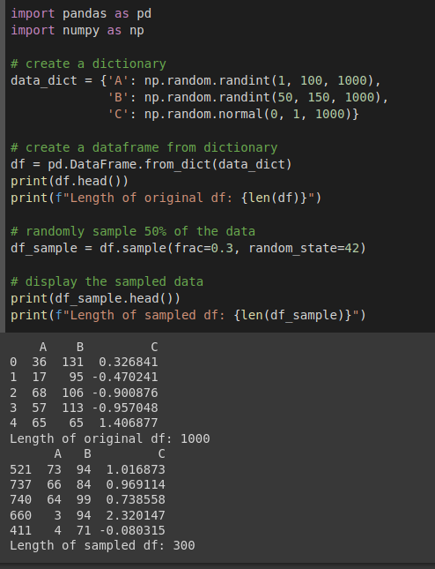
Reduction - Sampling
The practice of selecting a subset of observations or data points from a larger dataset, with the goal of gaining insights and knowledge about the population that the data represents.

Slide 38
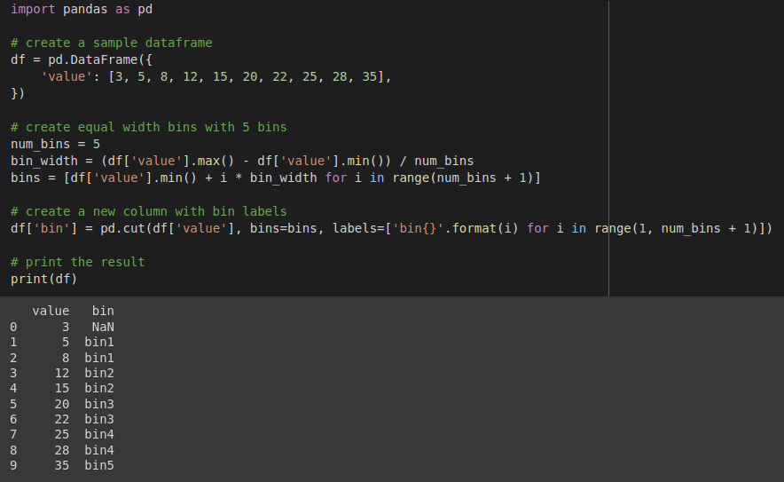
Discretization - Equal width discretization
A technique that divides the continuous data into intervals of equal width.
In this technique, the range of values is divided into a fixed number of bins, and each bin has an equal width.
The width of each bin is determined by the range of values divided by the number of bins.
Data values falling within a specific bin are then mapped to that bin's midpoint or some other representative value.

Slide 39
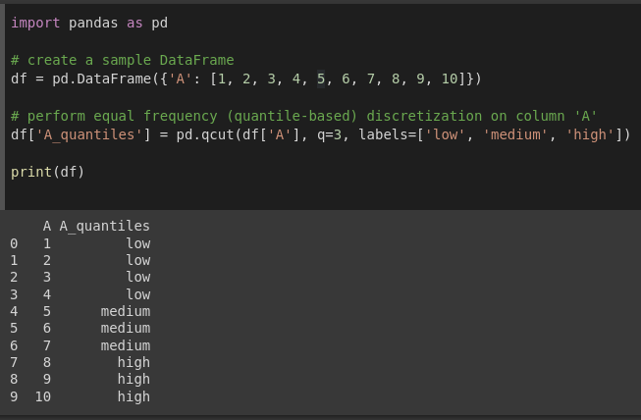
Discretization - Equal Frequency discretization
A technique used in data preprocessing to convert a continuous variable into a categorical variable.
In this technique, the range of values for the continuous variable is divided into equal-sized intervals based on the frequency of values in the dataset.
Each interval is assigned a unique category label.

